Slide 1
Quantification of pinking response
Update with v2 of images

Slide 2
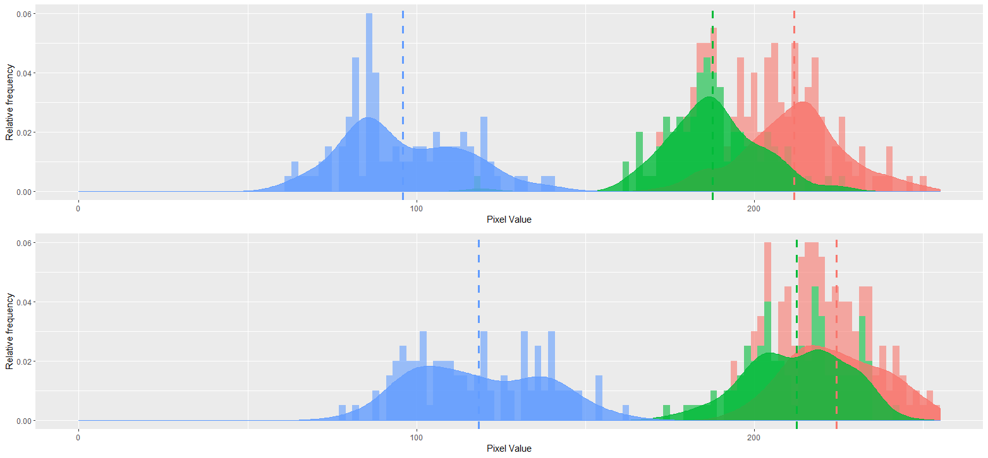
Color difference is detectable
Control
Melatonin 1000 ppm

Slide 3
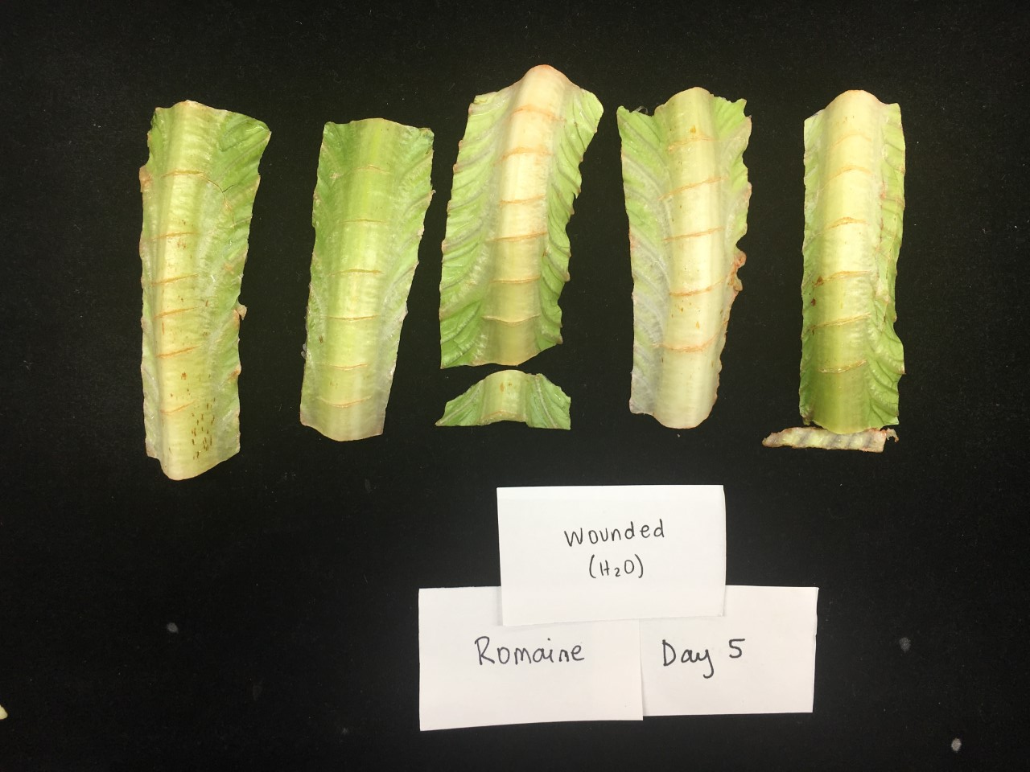
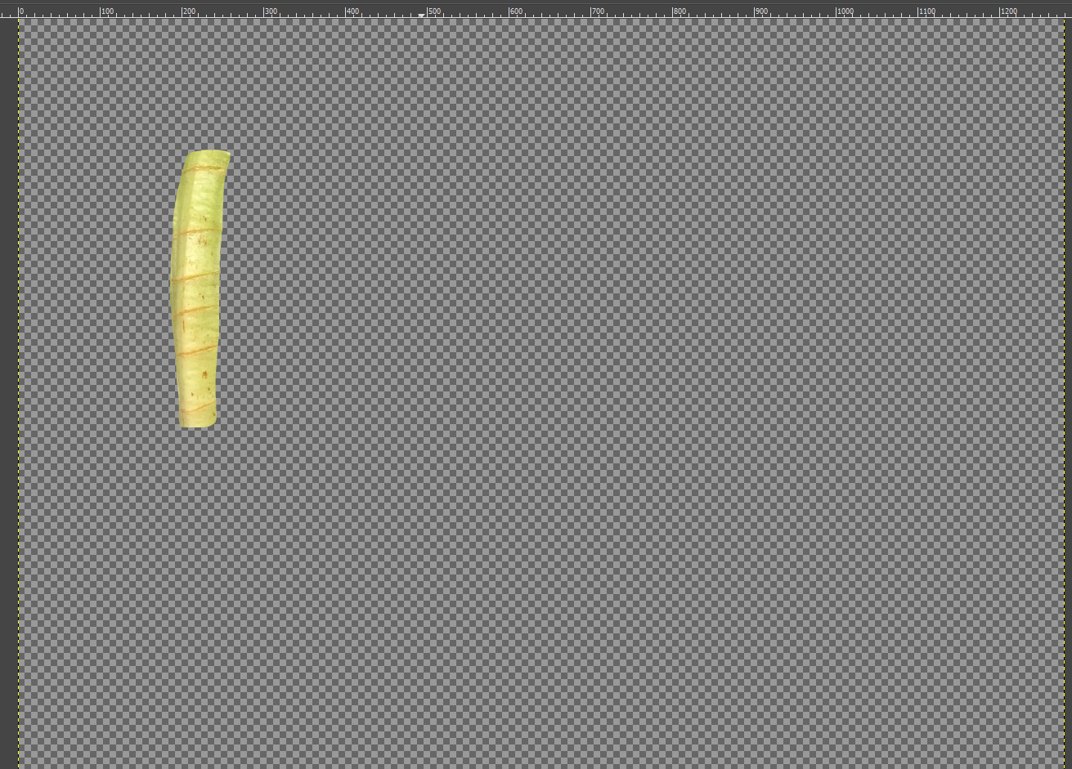
Image processing method

Slide 4
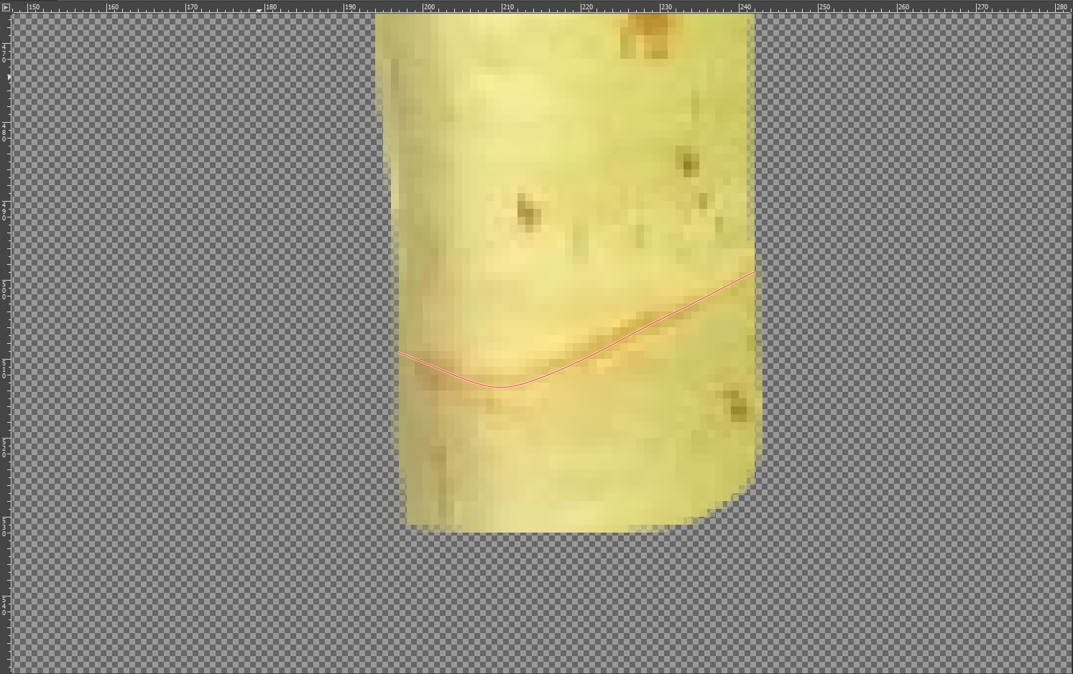
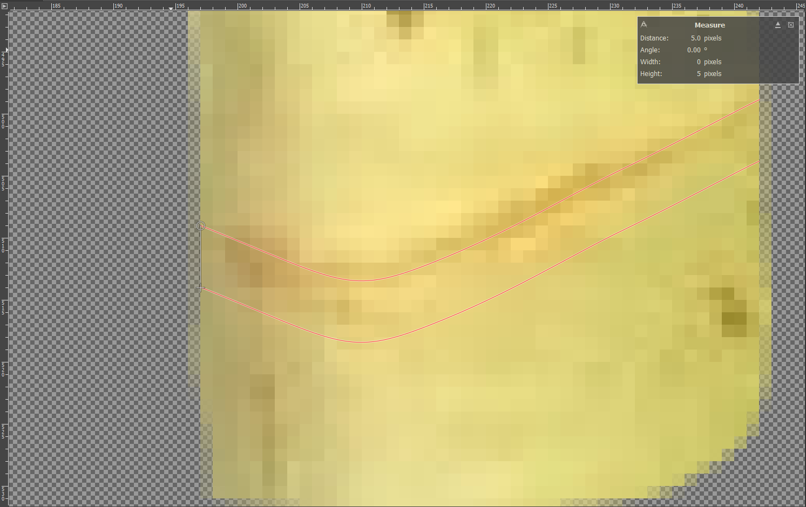
Image processing method
Currently using height of 1 mm – set scale with ruler

Slide 5
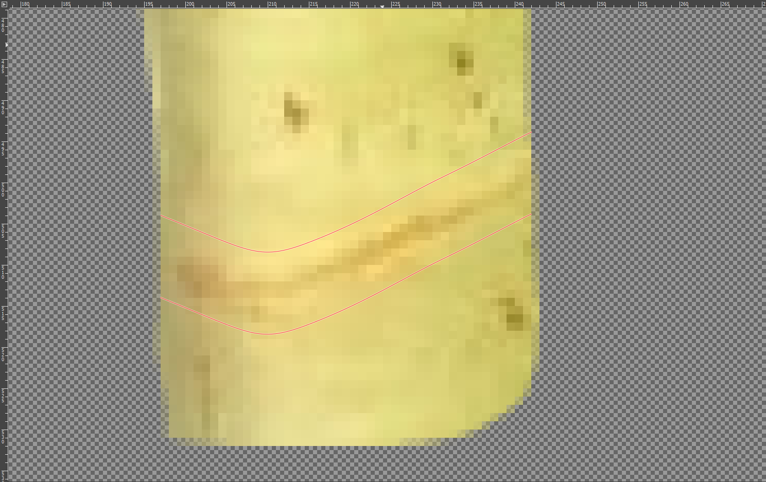
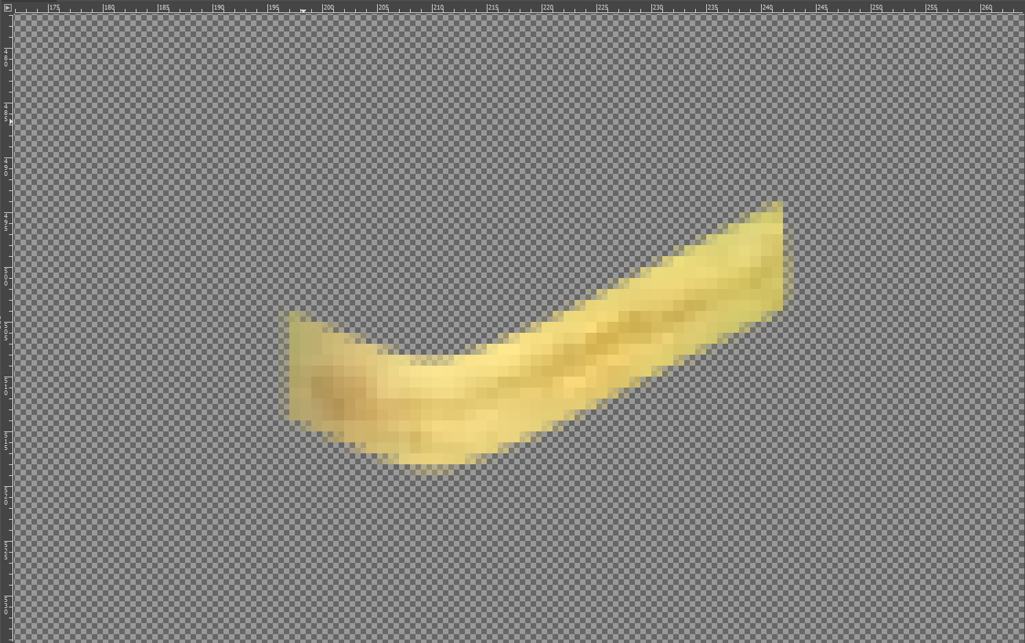
Image processing method

Slide 6
Quantifying pinking response – Method 1
Calculate % of pixels that meet threshold to be considered pink:
Define “pink” with manually selected pixels
Count pixels in area that meet threshold
Divide by total pixels in area
Calculate day-to-day difference in % pink on a per-cut site basis

Slide 7
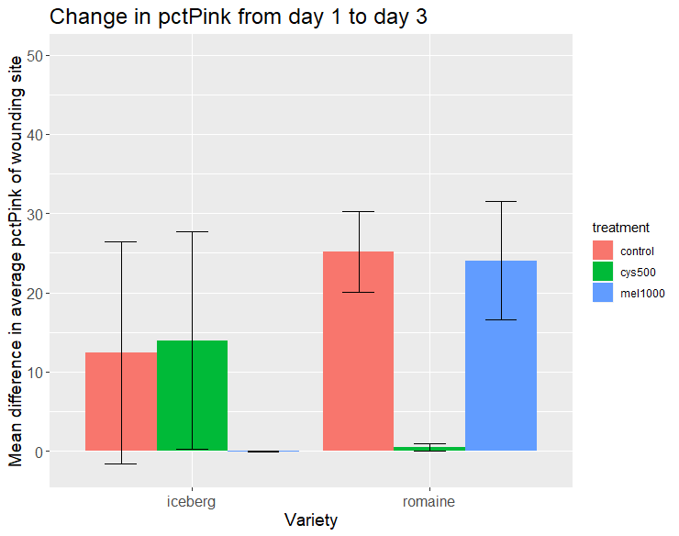
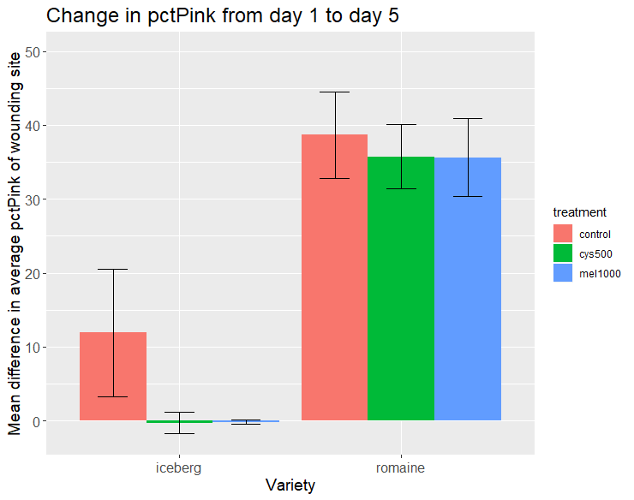
Method 1 data – 1 rib

Slide 8
Quantifying pinking response – Method 2
Calculate average value of a*:
Convert image from RGB to L*a*b* color space
Calculate average of a* component for each cut site
More (+) a* = more pink
Calculate day-to-day difference in average a* on a per-cut site basis

Slide 9
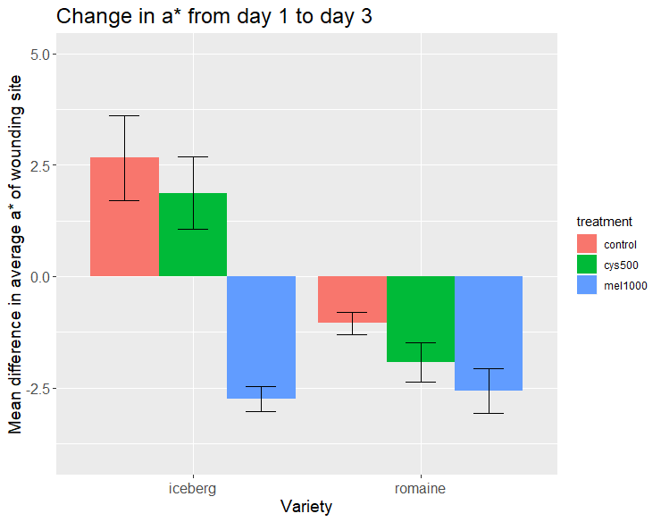
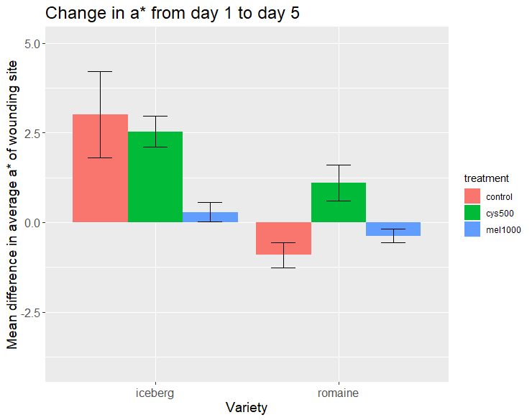
Method 2 data – 1 rib

Slide 10
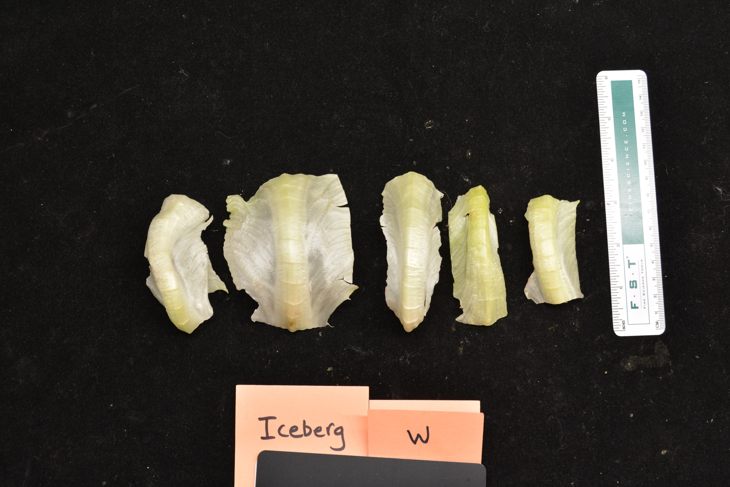
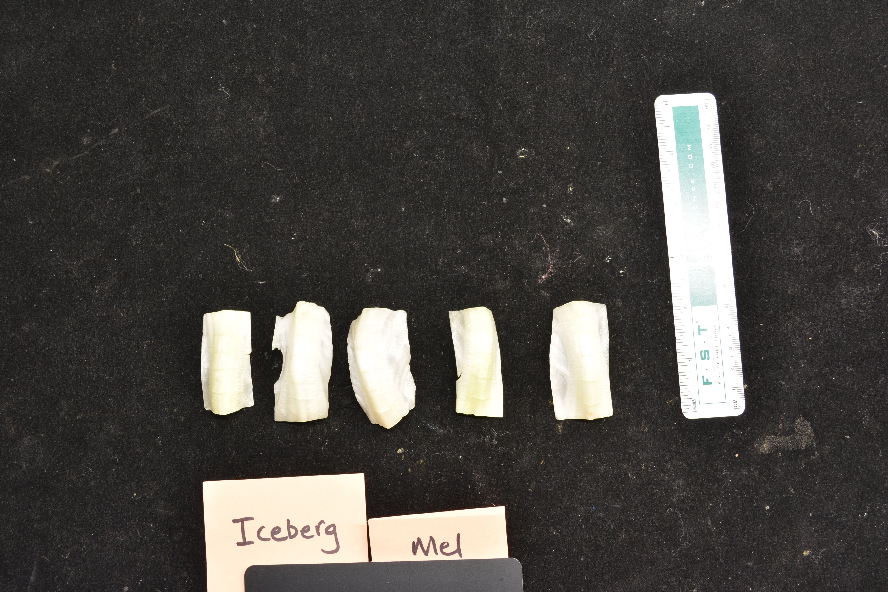
Challenges
Differences in exposure between photos

Slide 11
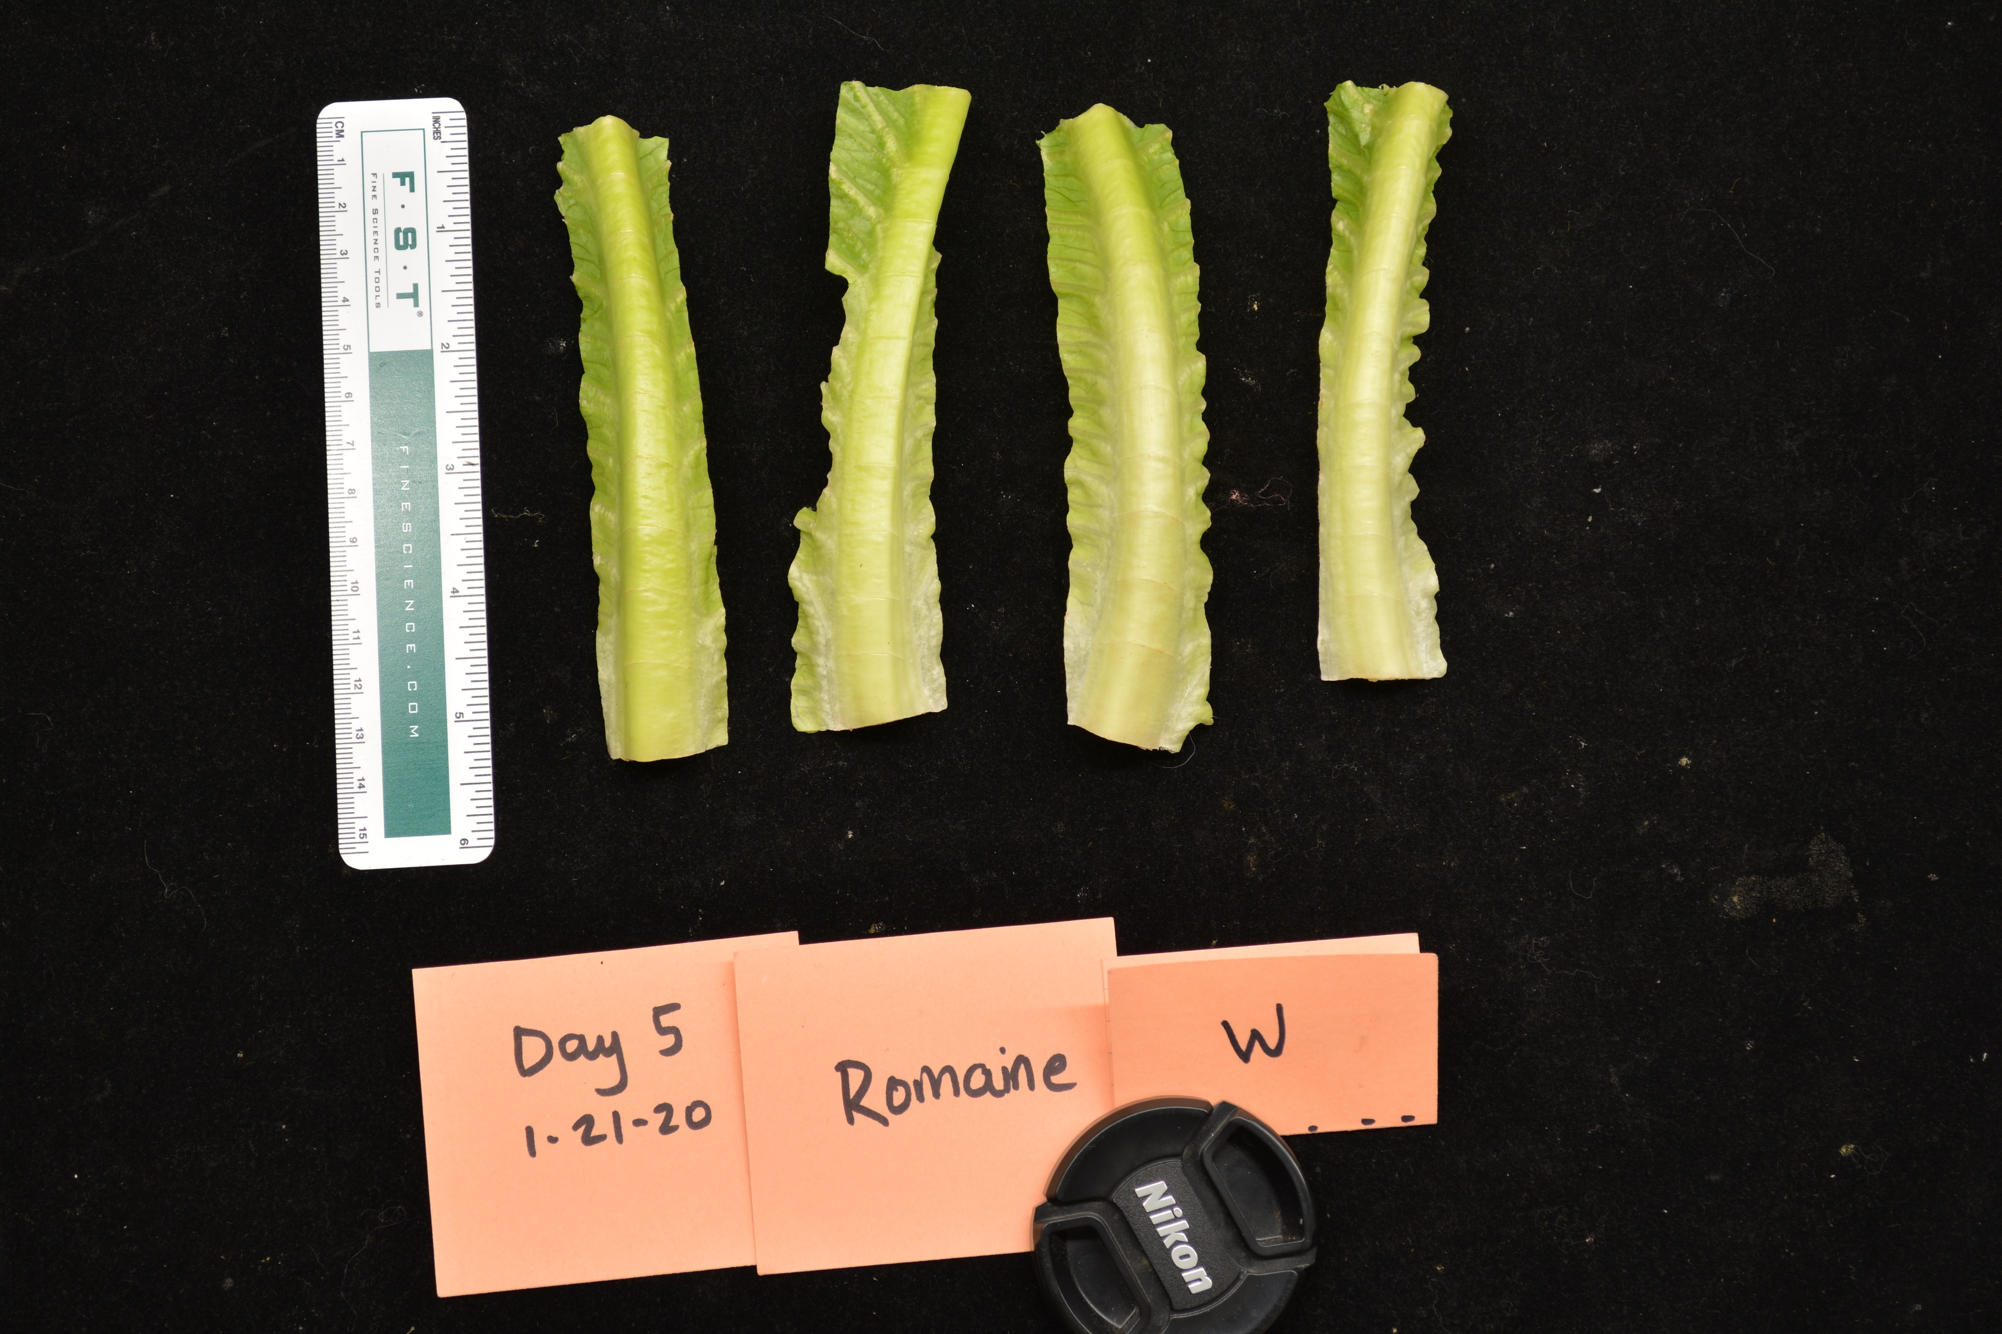
Challenges
Romaine pinking is not as apparent vs previous run

